Slide 1
Instruction Set Principles and Examples
(Appendix A)

Slide 2
Outline
Classifying Instruction Set Architecture
Memory addressing
Type and size of Operands
Operations in the Instruction Set
Instructions for Control Flow
Encoding an Instruction Set
Crosscutting Issues: The Role of Compilers
Putting It All Together: The RISC-V Architecture

Slide 3
Classifying Instruction Set
Architectures
There are two major components in a CPU:
register file and Arithmetic and Logic Unit (ALU).
A register file is used to hold the operands (source data for computation) and computation results.
A register file can be a stack, an accumulator or a set of general purpose registers.
An ALU is used to carry out the computation. It takes source data from the register file or external memory. Its computation results are also stored back to register file or external memory.

Slide 4
CPU
Register
File
ALU
Memory

Slide 5
There are four instruction set architecture (ISA) classes:
(a) Stack: for CPU with a stack.
(b) Accumulator: for CPU with an accumulator.
(c) Register-Memory: for CPU with general purpose registers.
(d) Register-Register/Load-Store: for CPU with general purposed registers.

Slide 6
Stack
The first operand is pointed by the Top of Stack
(TOS) register.
The second operand is right below the first operand.
The result takes place of the second operand, and
the first operand is removed from the stack.
The TOS is updated to point to the second operand.
All operands are implicit for ALU instructions. Data can be
transferred between stack and memories via instructions
push and pop.

Slide 7
Accumulator
The accumulator is both an implicit input and a result.
Register-Memory
One input operand is a register, one is in memory, and
the result goes to a register.
Register-register/Load-store
All operands are registers. The results goes to a register.
Data can be transferred between registers and memories
via instructions load and store.

Slide 8
Example:
The code sequence for C=A+B for four classes of
instruction set.
Stack | Accumulator | Register- Memory | Register-Register
Push A Push B Add Pop C | Load A Add B Store C | Load R1, A Add R3,R1,B Store R3,C | Load R1,A Load R2,B Add R3,R1,R2 Store R3,C
Here we assume A, B and C all belong in memory.

Slide 9
Stack operations
stack
memory
Initial
TOS→
A | aa
B | bb
C | xx
TOS→ | aa
ADD
TOS→ | aa+bb
PUSH A
TOS→ | bb
 | aa
POP C
TOS→
PUSH B
stack
memory
Final
TOS→
A | aa
B | bb
C | aa+bb

Slide 10
Accumulator operations
memory
accumulator
Initial
A | aa
B | bb
C | xx
LOAD A
aa
ADD B
aa+bb
STORE C
aa+bb
memory
accumulator
Final
A | aa
B | bb
C | aa+bb
aa+bb

Slide 11
Resister-Memory
Register
memory
Initial
R1
R2
R3
A | aa
B | bb
C | xx
R1 | aa
R2
R3
Store R3, C
R1 | aa
R2
R3 | aa+bb
LD R1,A
R1 | aa
R2
R3 | aa+bb
ADD R3,R1,B
Register
memory
Final
R1 | aa
R2
R3 | aa+bb
A | aa
B | bb
C | aa+bb

Slide 12
Resister-Register
Register
memory
Initial
R1
R2
R3
A | aa
B | bb
C | xx
R1 | aa
R2
R3
ADD R3, R2,R1
R1 | aa
R2 | bb
R3 | aa+bb
LD R1,A
R1 | aa
R2 | bb
R3
Store R3, C
R1 | aa
R2 | bb
R3 | aa+bb
LD R2, B
Register
memory
Final
R1 | aa
R2 | bb
R3 | aa+bb
A | aa
B | bb
C | aa+bb

Slide 13
General-purpose register (GPR) computers
GPR computers
Register-memory
Register-register
(load-store)
Memory-memory
(not used today)
Although most early computers used stack or
accumulator-style architectures, virtually new
architecture designed after 1980 uses a load-store
register architecture.

Slide 14
There are two main reasons for using the GPR
computers:
Registers are faster than memory.
Registers are more efficient for a compiler to
use than other forms of internal storage.
Example: (A*B)-(B*C)-(A*D)
For GPR computers, the multiplication can be performed
in any order, which may be more efficient because of the
location of operands or because of the pipeline concerns.
For stack computers, the multiplication can only be performed
in single order, and it may have to load an operand
multiple times.

Slide 15
Two major instruction set characteristics divides GPR
architectures.
Maximum number of operands allowed for
ALU instructions (2 or 3).
2. Number of memory operands for ALU instructions
(0,1,2 or 3).

Slide 16
Examples of the GPR computers are shown below.
Number of Memory Addresses | Maximum Number of Operands | Type of Architecture | Examples
0 | 3 | Load-Store | ARM, MIPS, PowerPC, SPARC, RISC-V
1 | 2 | Register-memory | Intel 80x86, Motorola 680000, TI TMS320C54
2 | 2 | Memory-Memory | VAX
3 | 3 | Memory-Memory | VAX

Slide 17
Memory Addressing
Interpreting memory addresses
Here we study what object is accessed as the function
of address and length.
All instruction sets discussed in this course are byte-
addressed and provide access for bytes (8 bits),
half words (16 bits), words (32 bits) and double
words (64 bits).

Slide 18
Little Endian and Big Endian
There are two different conventions for ordering
bytes within a larger object: little endian and
big endian.
Little endian byte order puts the byte whose address
is “x…x000” at the least-significant position in the
double word.
Most significant position
Least significant position
7 (x…x111) | 6 | 5 | 4 | 3 | 2 | 1 | 0 (x…x000)
Double Word

Slide 19
Big endian byte order puts the byte whose address
is “x…x000” at the most-significant position in the
double word.
Most significant position
Least significant position
0 (x…x000) | 1 | 2 | 3 | 4 | 5 | 6 | 7 (x…x111)
Double Word

Slide 20
Aligned memory access
An access to an object of size s bytes at byte address A
is aligned if
A mod s =0.

Slide 21
Addressing Modes
The following shows the most common names for the addressing modes.
Addressing Mode | Example | Meaning
Register | ADD R4,R4,R3 | Reg[R4]⬅Reg[R4]+Reg[R3]
Immediate | ADD R4,R4,3 | Reg[R4]⬅Reg[R4]+3
Displacement | ADD R4,R4,100(R1) | Reg[R4]⬅Reg[R4]+MEM[100+Reg[R1]]
Register Indirect | ADD R4,R4,(R1) | Reg[R4]⬅Reg[R4]+MEM[REG[R1]]
Indexed | ADD R4,R4,(R1+R2) | Reg[R4]⬅Reg[R4]+ MEM[Reg[R1]+Reg[R2]]
Memory Indirect | ADD R4,R4,@(R3) | Reg[R4]⬅Reg[R4]+ MEM[MEM[Reg[R3]]]
Scaled | ADD R4,R4,100(R1)[R2] | Reg[R4]⬅Reg[R4]+ MEM[100+Reg[R1]+Reg[R2]*d]

Slide 22
Addressing modes have the ability to significantly
reduce instruction counts; they also add to the complexity
of building a computer and may increase the average CPI.
Therefore, the usage of various addressing mode is quite
important in helping the architect choose what to include.
We consider the results of measuring addressing
mode usage patterns in three programs on the VAX
architecture. The old VAX architecture is used here
because it has the richest set of addressing modes.

Slide 23
Frequency of addressing mode for VAX architecture
 | Memory Indirect | Scaled | Register Indirect | Immediate | Displacement
tex | 1% | 0 | 24% | 43% | 32%
spice | 6% | 16% | 3% | 17% | 55%
gcc | 1% | 6% | 11% | 39% | 40%
As the table shows, immediate and displacement
addressing dominate addressing mode usage.

Slide 24
Displacement addressing mode
The range of displacement is important for the
displacement addressing mode since it affects
the instruction length.
The following shows the measurements taken
on the data access on a load-store architecture
using the benchmark programs.

Slide 25
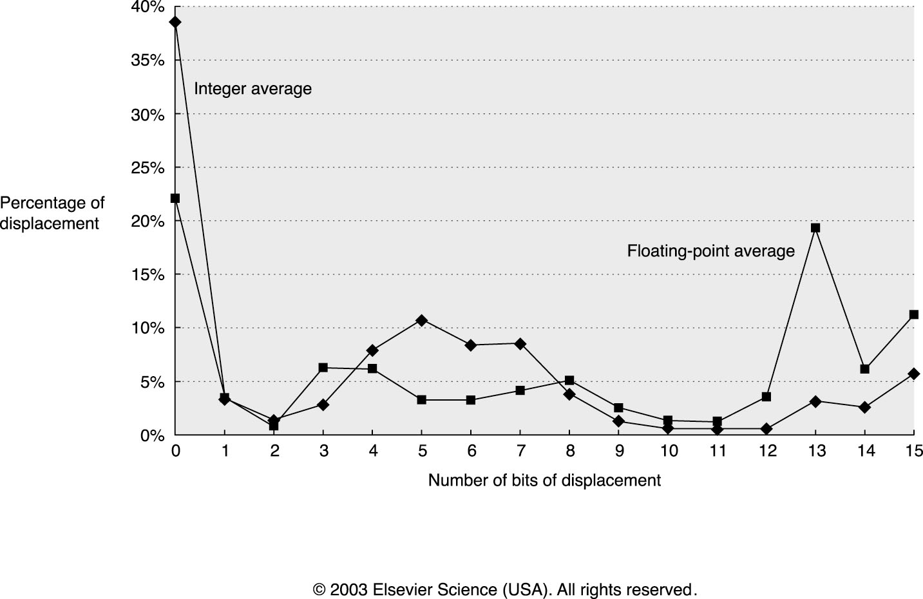
(measured on CINT2000 integer programs)
(measured on CFP2000 floating point programs)
Alpha architecture
SPEC CPU2000
Note that the graph does not include the sign bit.
From the figure, we see that the displacement values
are widely distributed.

Slide 26
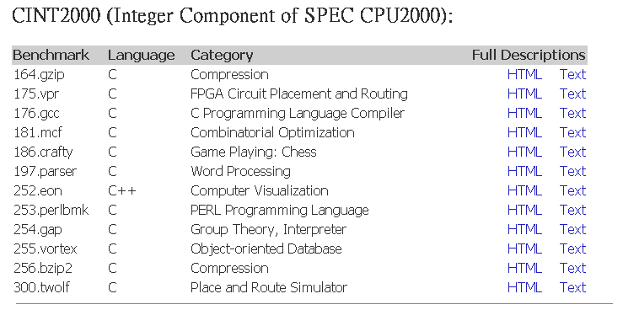
CINT2000 Benchmark

Slide 27
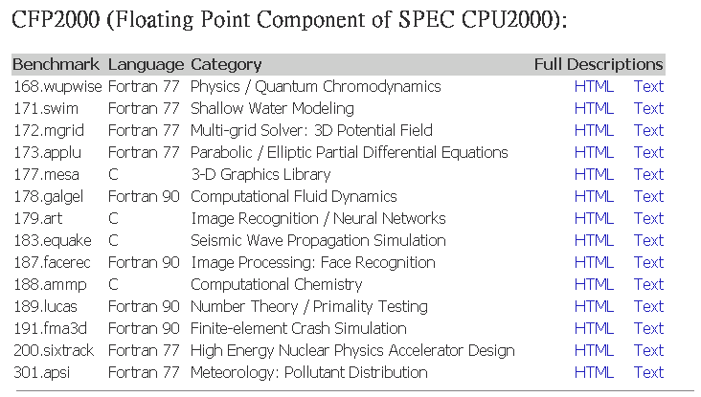
CFP2000 Benchmark

Slide 28
Immediate addressing mode
For the use of immediates it is important to know
whether they need to be supported for all operations
or for only a subset.
Another important instruction set measurement is
the range of values for immediates.

Slide 29
Frequency of instructions using immediate values
Alpha architecture
SPEC CPU2000
 | Loads | ALU Operations | All Instructions
Floating Point (CFP2000) | 22% | 19% | 16%
Integer (CINT2000) | 23% | 25% | 21%
Here we see that about ¼ of the loads and ALU
operations have an immediate operands.

Slide 30
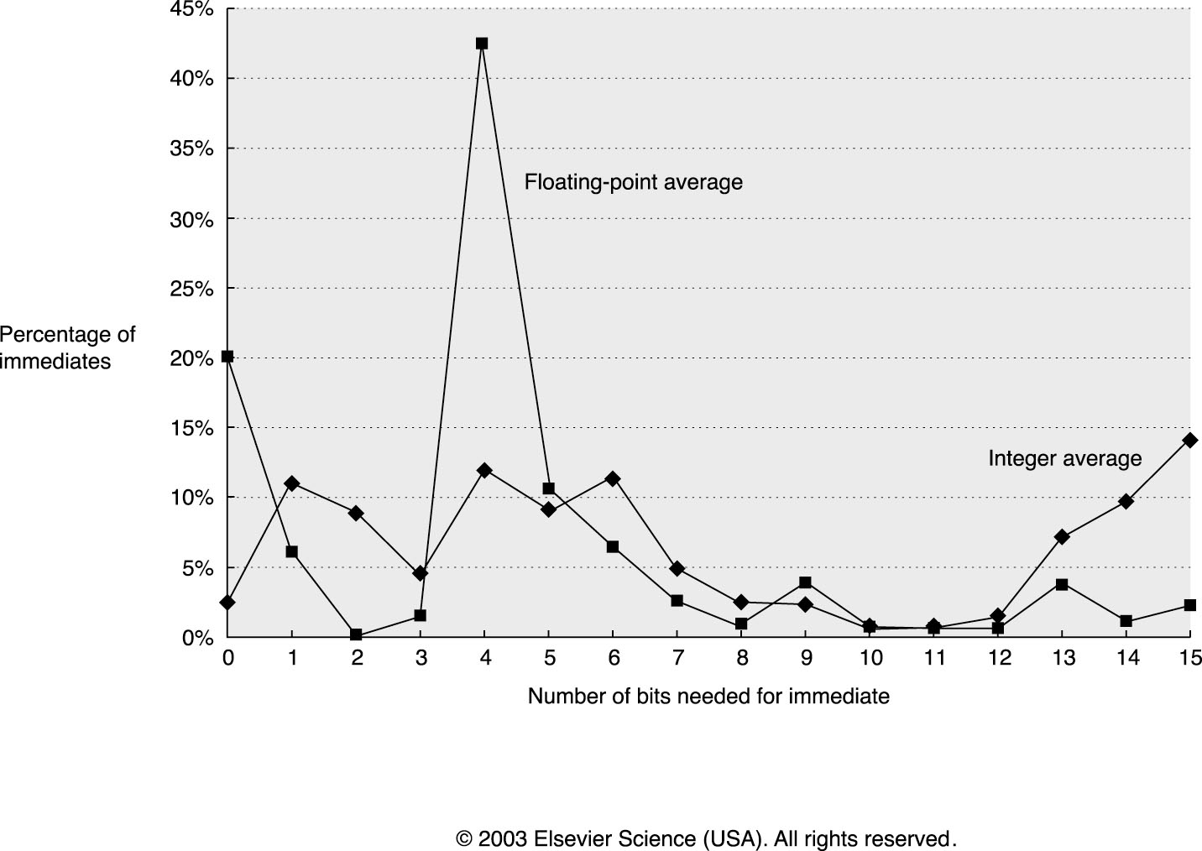
(measured on CFP2000 floating point programs)
(measured on CINT2000 integer programs)
Alpha architecture
SPEC CPU2000
The figure shows that small immediate values are
most heavily used. Large immediates are sometimes
used, however, most likely in addressing calculations.

Slide 31
Type and size of operands
Common operand types include character (8 bits),
half word (16 bits), word (32 bits), single-precision
floating point (also 1 word), and double-precision
floating point (2 words).
Integers are represented as 2’s complement binary
numbers. Characters are in ASCII or Unicode. Floating
points are based on IEEE standard 754.
For business applications, some architectures support
a decimal format, usually called packed decimal or binary
coded decimal, where 4 bits are used to encode values 0-9,
and 2 decimal digits are packed into each byte.

Slide 32
Operations in the instruction set
The operators supported by most instruction set
architectures can be categorized as follows.
Operator type | Example
Arithmetic and logical | Integer arithmetic and logical operations: add, sub, and, or, mul and div
Data transfer | Load and store
Control | Branch, call and return
System | Operating system call, virtual memory management instructions
Floating point | Floating point operations: add, mul, div and compare
Decimal | Decimal add, decimal mul
String | String compare, string move
Graphics | Pixel and vertex operations

Slide 33
Rank | 80x86 instructions | % of total executed
1 | Load | 22%
2 | Conditional Branch | 20%
3 | Compare | 16%
4 | Store | 12%
5 | Add | 8%
6 | And | 6%
7 | Sub | 5%
8 | Move | 4%
9 | Call | 1%
10 | Return | 1%
Total |  | 96%
Here we shows 10 simple instructions that account
for 96% of instructions executed for a collection of
integer programs running on Intel 80x86. Hence,
the implementation of these instructions should be
sure to make these fast.

Slide 34
Instructions for control flow
There are four different types of instructions for
flow control:
Conditional branches
Jump
Procedure calls
Procedure returns

Slide 35
Frequency of branch instructions
 | Call/Return | Jump | Conditional Branch
Floating Point (CFP2000) | 8% | 10% | 82%
Integer (CINT2000) | 19% | 6% | 75%
Alpha architecture
SPEC CPU2000
It is clear from the figure that conditional branch
is the most frequently used instruction.

Slide 36
Addressing Modes for Control Flow Instructions
The addressing mode is dependent on whether the
target address is available at compile time.
Target address is available
In this case, we can specify the target address explicitly.
The most common way to specify the destination is
to supply the displacement that is added to the program
counter (PC). Control flow instructions of this sort are
called PC-relative.

Slide 37
PC-relative branches have the following advantages
Because the target is often near the current position,
specifying the position relatively to the current PC
requires fewer bits.
Using PC-relative addressing also permits the code to
run independently of where it is loaded.

Slide 38
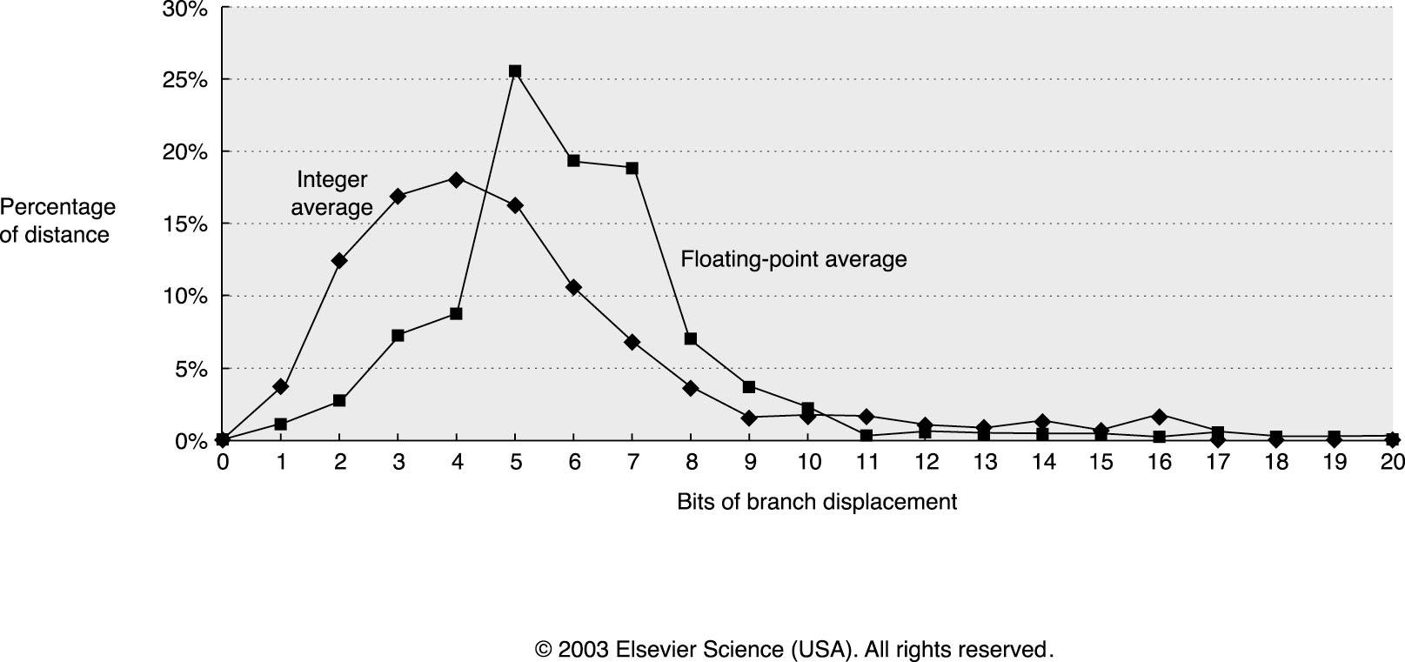
(measured on CINT2000 integer programs)
(measured on CFP2000 floating point programs)
Alpha architecture
SPEC CPU2000
From the figure, we see that the most frequent
branches in the integer programs are to targets that
can be encoded in 4-8 bits.

Slide 39
Target address is not available
To implement returns and indirect jumps when the
target is not known at compile time, a method other
then PC-relative addressing is required.
A common addressing mode for this case is the register-
indirect mode, where the target address is contained in
a register.

Slide 40
Conditional Branch Options
Since most changes in control flow are branches, deciding
how to specify the branch condition is important.
There are three major approaches: Condition code,
Condition register, Compare and branch

Slide 41
Name | CPU | Code Example | Advantages
Condition Code | 80x86 ARM PowerPC SPARC | SUB R1,R2,R3 BNZ Target | Sometime condition is set for free
Condition Register | Alpha, MIPS | SUB R1,R2,R3 BNZ R1,Target | Simple
Compare and branch | RISC-V VAX | BNE R2,R3, Target | One instruction rather than two for a branch

Slide 42
The following shows the frequency of different
comparisons for conditional branch.
Alpha architecture
SPEC CPU2000
 | Not equal | Equal | Greater than or equal | Greater than | Less than or equal | Less than
Floating Point (CFP2000) | 5% | 16% | 0% | 0% | 44% | 34%
Integer (CINT2000) | 2% | 18% | 11% | 0% | 33% | 35%
From the figure, we see that compare equal, compare
not equal and compare less account for approximately
90% of comparisons.

Slide 43
Encoding an instruction set
The architect must balance several competing forces when
encoding the instruction set:
The desire to have as many registers and addressing
modes as possible.
The impact of the size of the register and addressing
mode fields on the average instruction size and hence
on the average program size.
A desire to have instructions encoded into lengths that
will be easy to handle in a pipelined implementation.

Slide 44
The following shows three popular choices for
encoding the instruction set.
Operation and no. of operands | Address specifier 1 | Address field 1 | … | Address specifier n | Address field n
Variable (Intel 80x86, VAX)
Operation | Address field 1 | Address field 2 | Address field 3
Fixed (RISC V, ARM, Power PC)
Operation | Address specifier | Address field
Operation | Address specifier | Address field 1 | Address field 2
Hybrid (RISC V Compressed, IBM 360/370, ARM Thumb2)

Slide 45
The variable format has the smallest program size.
The fixed format is well-suited for pipeline
implementation. Therefore, it has the highest
performance.
The hybrid format may have the advantages of
both variable and fixed formats.

Slide 46
Crosscutting Issues: The role of Compilers
Register allocation
Register allocation plays the central role both in speeding
up the code and in making other optimization useful.
Therefore, it is one of the the most important optimization
for a compiler.
The register allocation algorithms today are based on
a technique called graph coloring. The technique works
best when there are at least 16 general-purpose registers
available for global allocation for integer variables.

Slide 47
How the architect can help the compiler
writer
Provide regularity
The three primary components of an instruction set (the
operations, the data types and the addressing modes)
should be orthogonal (i.e., independent).
Provide primitives, not solutions
Special features that “match” a language construct or a
kernel function are often unusable.

Slide 48
Putting It All Together: The RISC-V Architecture
In this section we describe a simple 64-bit architecture
called RISC-V, which emphasizes
A simple load-store instruction set
Design for pipelining efficiency
Efficiency as a compiler target

Slide 49
RISC-V Overview
The RISC-V instruction set is organized as three base
instruction sets (namely RV32I, RV32E and RV64I), and
a varieties of optional extensions.
Name | Functionality
RV32I | Base 32-bit integer instruction with 32 registers
RV32E | Base 32-bit integer instruction with 16 registers
RV64I | Base 64-bit instruction set; All registers are 64-bits
M | Integer multiply and divide
A | Automic instructions for concurrent operations
F | Single precision floating point instructions
D | Double precision floating point instructions
V | Vector operations
P | SIMD instructions

Slide 50
Both RV32I and RV32E are used only for small embedded
processors.
We call the RV64I with extensions M, A, F, and D
the RV64G.
That is, RV64G=RV64I+M+A+F+D.
RV64G can be used for a larger varieties of computers.
We consider only RV64G in this chapter.

Slide 51
Registers for RISC-V
RV64G has 32 64-bit general-purpose registers (GPRs),
named x0,…,x31. GPRs are also sometimes known as
integer registers.
RV64G also contains 32 floating-point registers (FPRs),
names f0,…,f31, which can hold 32 single precision
(32-bit) values or 32 double precision (64-bit) values.
The value of x0 is always zero.

Slide 52
Data types for RISC-V
The data types are 8-bit bytes, 16-bit half words,
32-bit words, and 64-bit double words for integer data
and 32-bit single precision and 64-bit double
precision for floating point.

Slide 53
Addressing modes for RISC-V data transfers
The only data addressing modes are immediate and
displacement, both with 12-bit fields. Register indirect
is accomplished by placing 0 in the 12-bit displacement
field, and absolute addressing with a 12-bit field is
accomplished by using x0 as the base register.
Memory access should be byte addressable with
a 64-bit address. It uses Little Endian.
Memory accesses need not to be aligned. However,
unaligned accesses run extremely slow.
The only operations that affect memory are load and store.

Slide 54
RISC-V Instruction Format
There are 4 RISC-V instruction formats: R-type, I-type
S-type, and U-type. All the formats are 32-bit long with
7-bit primary opcode.
R-type, I-type and S-type are commonly used.

Slide 55
R-type format
funct7 | rs2 | rs1 | funct3 | rd | opcode
7
5
5
3
5
7
Register-Register ALU instructions.

Slide 56
Example:
add x1,x2,x3
funct7 | rs2 (3) | rs1 (2) | funct3 | rd (1) | opcode
Reg[x1] ⬅ Reg[x2]+Reg[x3]

Slide 57
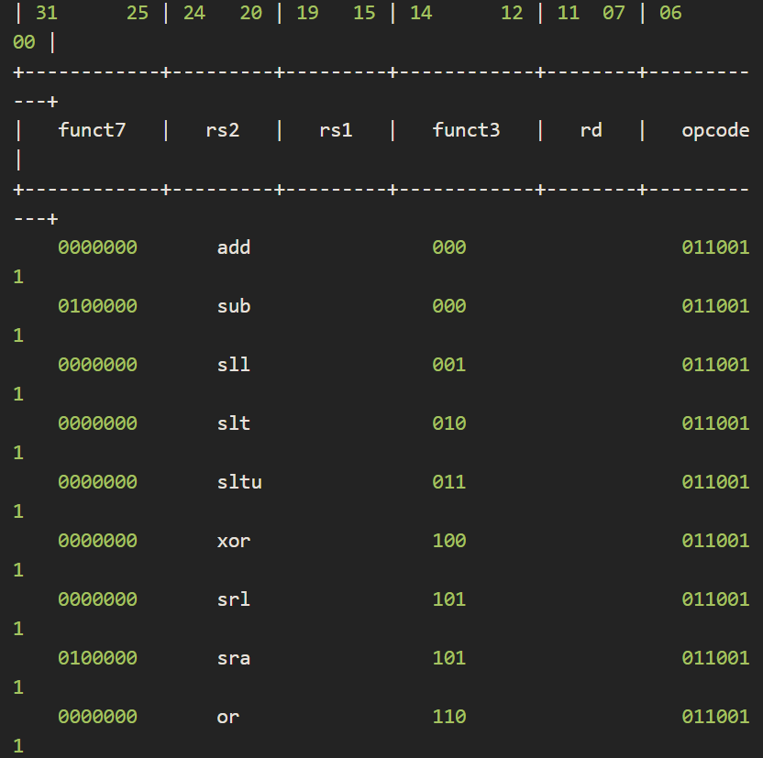
ALU instructions such as add, sub, sll, srl, xor, or share the same
opcode=0110011, but have different funct3 and func7 values.
Opcode=
0110011

Slide 58
I-type format
Immediate [11:0] | rs1 | funct3 | rd | opcode
12
5
3
5
7
Load instructions.
Register-Immediate ALU instructions.

Slide 59
Example:
ld x1,80(x2)
Immediate (80) | rs1 (2) | funct3 | rd (1) | opcode
Reg[x1] ⬅ MEM[Reg[x2]+80]

Slide 60
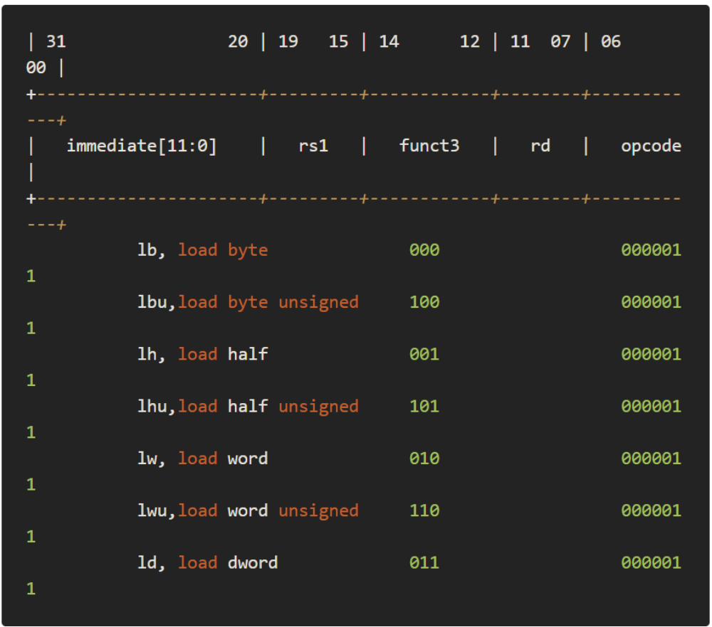
Load instructions such as ld, lw, lh, lb share the same
opcode=0000011, but have different funct3 values.
Opcode=
0000011

Slide 61
Example:
addi x1,x2,68
Immediate (68) | rs1 (2) | funct3 | rd (1) | opcode
Reg[x1] ⬅ Reg[x2]+68

Slide 62
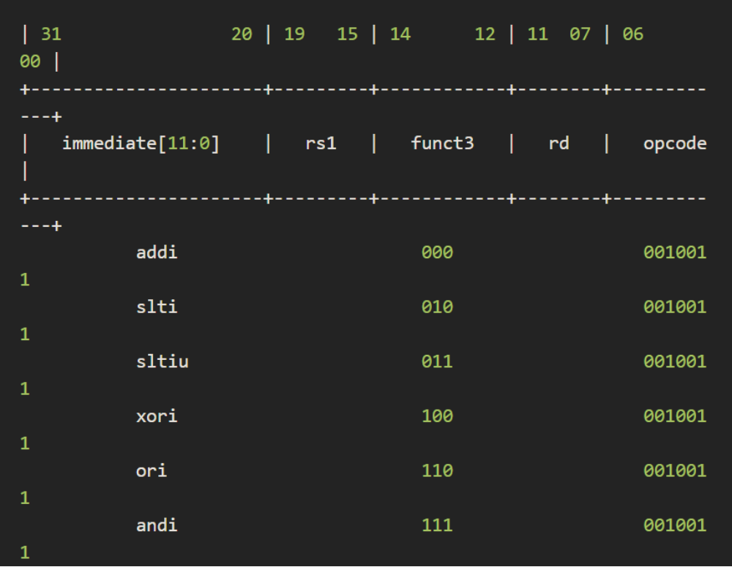
ALU instructions such as addi, slti, xori, ori, andi share the same
opcode=0010011, but have different funct3 values.
Opcode=
0010011

Slide 63
S-type format
Imm [11:5] | rs2 | rs1 | funct3 | Imm [4:0] | opcode
7
5
5
3
5
7
Store Instructions
Conditional Branch Instructions

Slide 64
Example:
sd x1,80(x2)
Imm [11:5] | rs2 (1) | rs1 (2) | funct3 | Imm [4:0] | opcode
Imm[11:0]=80
MEM[Reg[x2]+80] ⬅ Reg[x1]

Slide 65
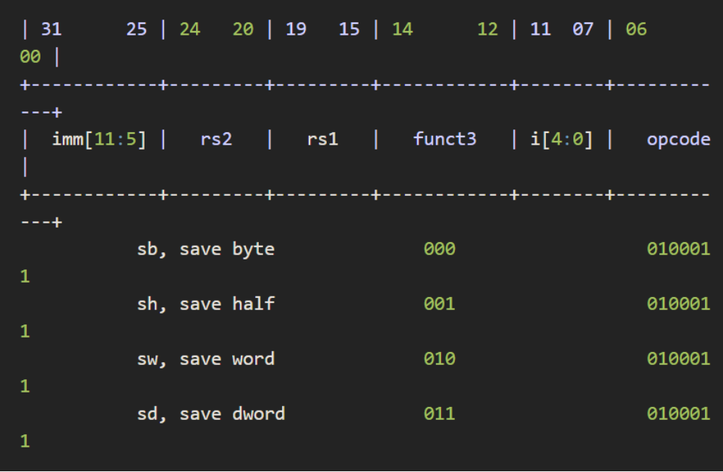
Store instructions such as sb, sh, sw, sd share the same
opcode=0100011, but have different funct3 values.

Slide 66
Example:
beq x3,x4,100
Imm [11:5] | rs2 (4) | rs1 (3) | funct3 | Imm [4:0] | opcode
Imm[11:0]=100
If(Reg[x3]==reg[x4]) PC ⬅ PC +400

Slide 67
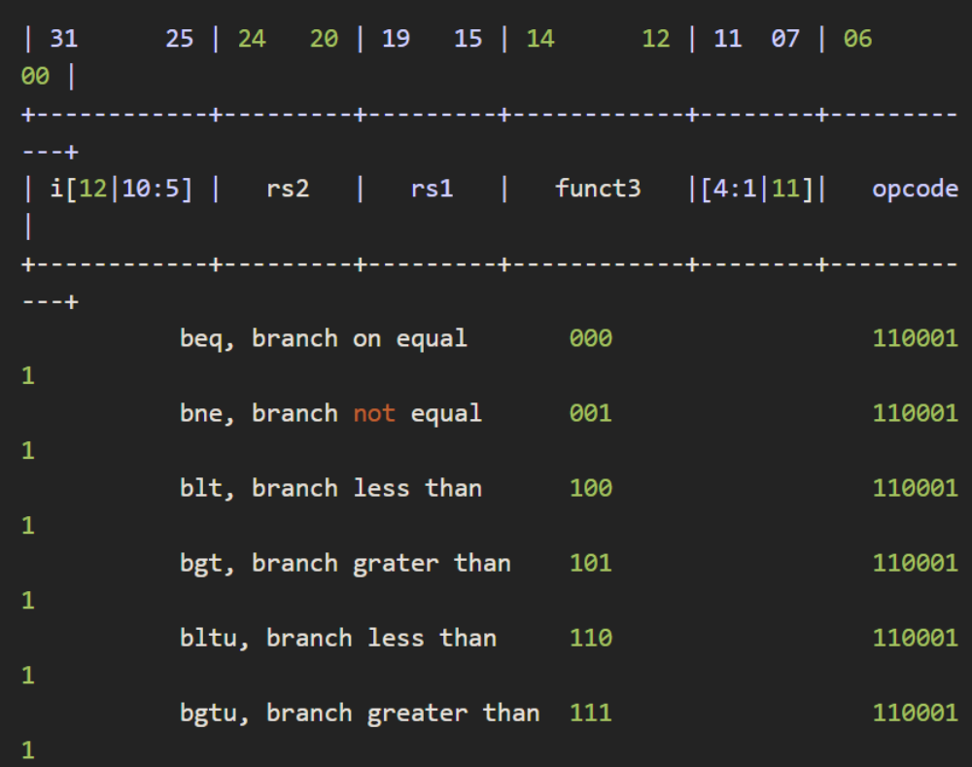
Branch instructions such as beq, bne, blt, bgt, bltu, bgtu
share the same opcode=1100011, but have different funct3
values.

